Slide 1
GitHub

Slide 2
Git History
Came out of Linux development community
Linus Torvalds, 2005
Initial goals:
Speed
Support for non-linear development (thousands of parallel branches)
Fully distributed
Able to handle large projects like Linux efficiently

Slide 3
Aside: So what is github?
GitHub.com is a site for online storage of Git repositories.
Many open source projects use it, such as the Linux kernel.
You can get free space for open source projects or you can pay for private projects.

Slide 4
Create a local copy of a repo
Two common scenarios: (only do one of these)
To clone an already existing repo to your current directory:
$ git clone <url> [local dir name]
This will create a directory named local dir name, containing a working copy of the files from the repo, and a .git directory
To create a Git repo in your current directory:
$ git init
This will create a .git directory in your current directory.
Then you can commit files in that directory into the repo:
$ git add file1.java
$ git commit –m “initial project version”

Slide 5
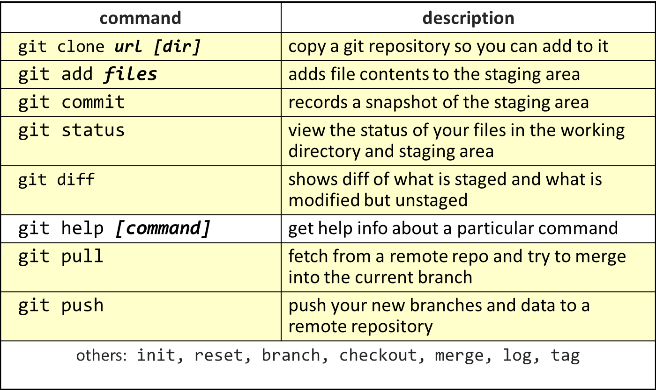
Git commands

Slide 6
Committing files
The first time we ask a file to be tracked, and every time before we commit a file we must add it to the staging area:
$ git add README.txt hello.java
This takes a snapshot of these files at this point in time and adds it to the staging area.
To move staged changes into the repo we commit:
$ git commit –m “Fixing bug #22”
Note: To unstage a change on a file before you have committed it:
$ git reset HEAD -- filename
Note: To unmodify a modified file:
$ git checkout -- filename

Slide 7
Status and Diff
To view the status of your files in the working directory and staging area:
$ git status or
$ git status –s
(-s shows a short one line version similar to svn)
To see what is modified but unstaged:
$ git diff
To see staged changes:
$ git diff --cached

Slide 8
After editing a file…
[rea@attu1 superstar]$ emacs rea.txt
[rea@attu1 superstar]$ git status
# On branch master
# Changes not staged for commit:
# (use "git add <file>..." to update what will be committed)
# (use "git checkout -- <file>..." to discard changes in working directory)
#
# modified: rea.txt
#
no changes added to commit (use "git add" and/or "git commit -a")
[rea@attu1 superstar]$ git status -s
M rea.txt ← Note: M is in second column = “working tree”
[rea@attu1 superstar]$ git diff ← Shows modifications that have not been staged.
diff --git a/rea.txt b/rea.txt
index 66b293d..90b65fd 100644
--- a/rea.txt
+++ b/rea.txt
@@ -1,2 +1,4 @@
Here is rea's file.
+
+One new line added.
[rea@attu1 superstar]$ git diff --cached ← Shows nothing, no modifications have been staged yet.
[rea@attu1 superstar]$

Slide 9
After adding file to staging area…
[rea@attu1 superstar]$ git add rea.txt
[rea@attu1 superstar]$ git status
# On branch master
# Changes to be committed:
# (use "git reset HEAD <file>..." to unstage)
#
# modified: rea.txt
#
[rea@attu1 superstar]$ git status -s
M rea.txt ← Note: M is in first column = “staging area”
[rea@attu1 superstar]$ git diff ← Note: Shows nothing, no modifications that have not been staged.
[rea@attu1 superstar]$ git diff --cached ← Note: Shows staged modifications.
diff --git a/rea.txt b/rea.txt
index 66b293d..90b65fd 100644
--- a/rea.txt
+++ b/rea.txt
@@ -1,2 +1,4 @@
Here is rea's file.
+
+One new line added.

Slide 10
Viewing logs
To see a log of all changes in your local repo:
$ git log or
$ git log --oneline (to show a shorter version)
1677b2d Edited first line of readme
258efa7 Added line to readme
0e52da7 Initial commit
git log -5 (to show only the 5 most recent updates, etc.)
Note: changes will be listed by commitID #, (SHA-1 hash)
Note: changes made to the remote repo before the last time you cloned/pulled from it will also be included here

Slide 11
Pulling and Pushing
Add and Commit your changes to your local repo
Pull from remote repo to get most recent changes (fix conflicts if necessary, add and commit them to your local repo)
Push your changes to the remote repo
To fetch the most recent updates from the remote repo into your local repo, and put them into your working directory:
$ git pull origin master
To push your changes from your local repo to the remote repo:
$ git push origin master
Notes: origin = an alias for the URL you cloned from
master = the remote branch you are pulling from/pushing to, (the local branch you are pulling to/pushing from is your current branch)

Slide 12
SVN vs. Git
SVN:
central repository approach – the main repository is the only “true” source, only the main repository has the complete file history
Users check out local copies of the current version
Git:
Distributed repository approach – every checkout of the repository is a full fledged repository, complete with history
Greater redundancy and speed
Branching and merging repositories is more heavily used as a result

Slide 13
Do This:
$ git config --global user.name “Your Name”
$ git config --global user.email youremail@whatever.com
$ git clone https://github.com/rea2000/santalist.git
Then try:
$ git log, $ git log --oneline
Create a file named userID.txt (e.g. rea.txt)
$ git status, $ git status –s
Add the file: $ git add userID.txt
$ git status, $ git status –s
Commit the file to your local repo: $ git commit –m “added rea.txt file”
$ git status, $ git status –s, $ git log --oneline
*WAIT, DO NOT GO ON TO THE NEXT STEPS UNTIL YOU ARE TOLD TO!!
from remote repo: $git pull origin master
Push to remote repo: $git push origin master
Pull

